Slide 1
Post Modernism
Created by
SADHANA SINGH YADAV
Course Instructor
Department of English
Pt. Deen Dayal Upadhayay Government Girls P.G. College
Rajajipuram, Lucknow

Slide 2
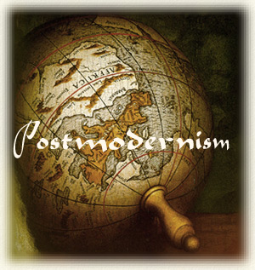
A Power Point Presentation On
Post Modernism

Slide 3
Dictionary definition of Post Modernism
a late 20th century style and concepts in the arts, architecture and criticism that represents a departure from modernism and has its heart a general distrust of grand theories and ideologies as well as a problematical relationship with any notion of “art”

Slide 4
Meaning Of Post Modernism
Postmodernism means a number of trends or movements in the arts and literature developing in the 1970s in reaction to or rejection of the dogma principles or practices of established modernism, especially a movement in architecture and influence of the International Style and encouraging the use of elements from historical informal styles and often playful illusion, decoration and complexity.

Slide 5
History of Post-Modernism
The term was first used around the 1870s in various areas. For example, John Watkins Chapman avowed “ a Postmodern style of painting” to get beyond French Impressionism. Then J. M. Thompson, in his 1914s article in The Hibbert Journal used the term Postmodernism to describe changes in attitudes and beliefs in the critique of religion. The term was then applied to a whole host of movements, many is art, music and literature, that reacted against a range of tendencies in the imperialist phase of capitalism called “modernism”, and are typically marked by revival of historical elements and techniques.

Slide 6
Post Modernism Literature
Postmodern literature is literature characterized by heavy reliance on techniques like fragmentation, paradox and questionable narrators, and is often defined as a style or trend which emerged in the post World War II era.
Postmodern works are seen as a reaction against Enlightenment thinking and Modernist approaches to literature.

Slide 7
Difference Between Modernism And Post Modernism
Modernism
Post-Modernism
. Began in the 1890 until 1945.
Modernism was based on using rational, logical means to gain knowledge.
It was characterized by a hierarchical and organized and determinate nature of knowledge.
Modernist approach was objective, theoretical and analytic. Postmodernism
. Began after world War II.
Postmodernism denied the application of logical thinking.
It was based on an anarchical, non-totalized and indeterminate state of knowledge.
Postmodernism approach was based on subjectivity.

Slide 8
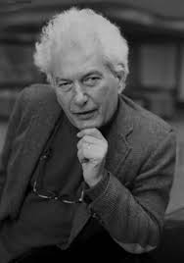

Post Modernist & Their Works
Joseph Heller
Catch 22

Slide 9
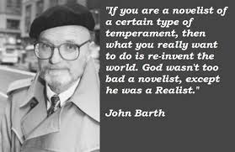

Post Modernist & Their Works
John Barth
Lost In The Funhouse

Slide 10


Post Modernist & Their Works
Tim O’Brien
The Things They Carried

Slide 11
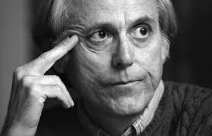

Post Modernist & Their Works
Don Delillo
White Noise

Slide 12
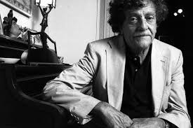

Post Modernist & Their Works
Kurt Vonnegut
Slaughter House-5

Slide 13
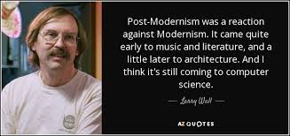
Larry wall says…

